Slide 1

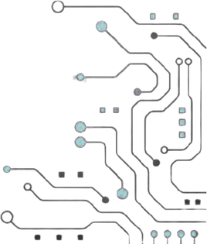



TEAM NAME : Chip Smiths
PROBELM STATEMENT NO : 11
Problem Statement Title : Sparse Weight Pruning and Run-Length Encoding Engine for Edge NPU
PS Category - Edge AI / TinyML
Software

Slide 2
Problem Statement
• Real-world problem : Edge AI models require large memory and computation, making deployment on resource-constrained devices difficult.
• Why it matters : Reducing model size and computation enables faster, more efficient, and low-memory AI inference on edge devices.
• Current challenges : Neural networks contain many redundant weights, while conventional storage and computation still process these unnecessary values.

Slide 3
yOur Solution
Project name : Sparse Weight Pruning and Run-Length Encoding Engine for Edge NPU
One-line solution : “Prune unnecessary neural-network weights and compress the remaining sparse weights using Run-Length Encoding to reduce memory and computation during edge inference.”
How it solves the problem : “It solves the problem by removing redundant weights, encoding the resulting sparse data efficiently, and reducing the workload required for neural-network inference.”

Slide 4
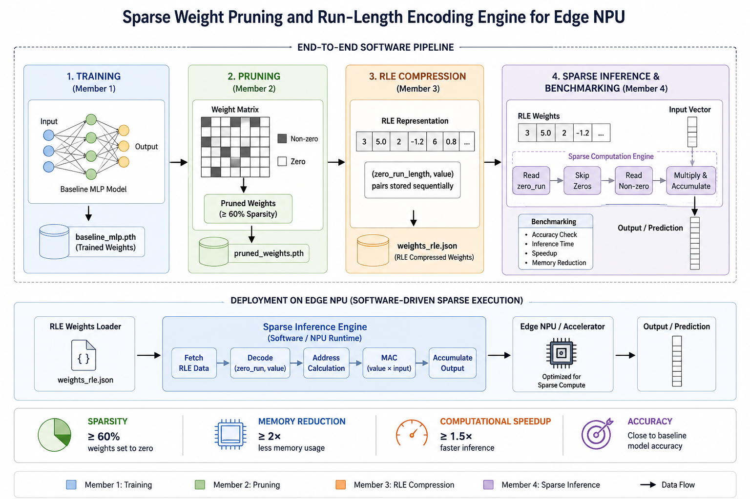
Architectural Block Diagram
insert pictures

Slide 5
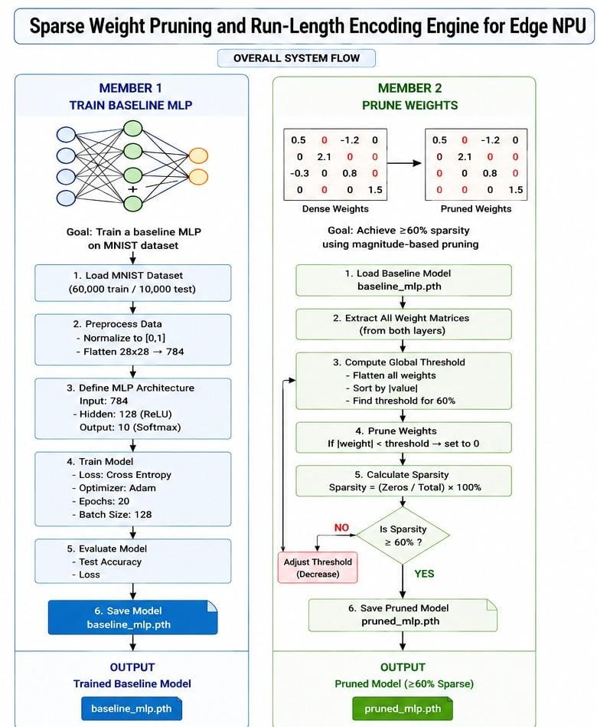
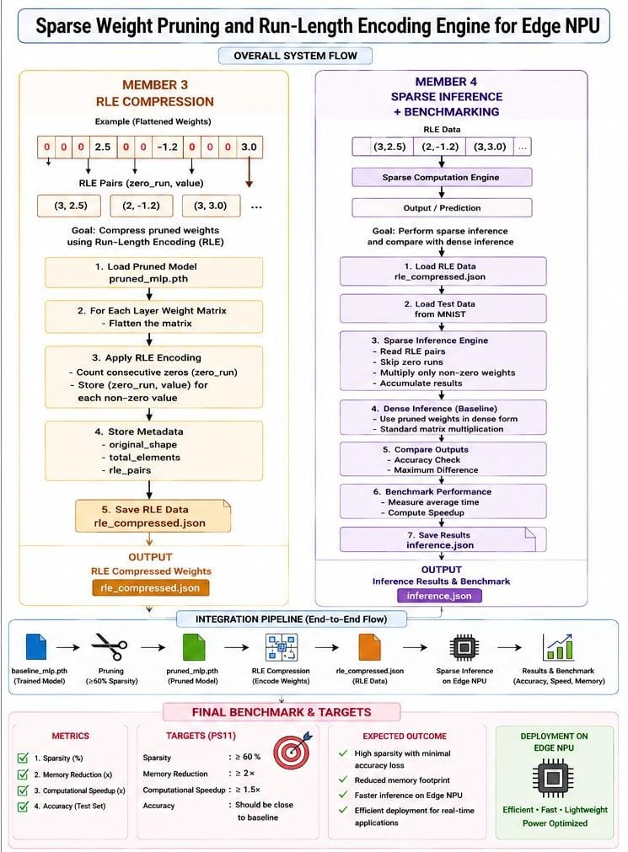

Slide 6
Purpose of Blocks
• Input Block – Loads and prepares the neural-network weights and input data. • Pruning Block – Removes less important weights to create a sparse model. • RLE Compression Block – Compresses consecutive zero weights to reduce storage. • Sparse Inference Block – Processes only non-zero weights to reduce computation. • Output Block – Produces the prediction and performance results.
IDEA BEHIND CHOOSING EACH BLOCK IN ARCHITECTURAL DIAGRAM AND WHAT ARE THE TRADE OFF OF YOUR ARCHITECTURAL CHOICE :
The blocks are arranged to progressively reduce model size and computation: pruning creates sparsity, RLE reduces storage, and sparse inference avoids unnecessary operations. The main trade-off is that higher compression and sparsity can reduce memory and computation but may slightly affect accuracy and add encoding/decoding complexity.

Slide 7
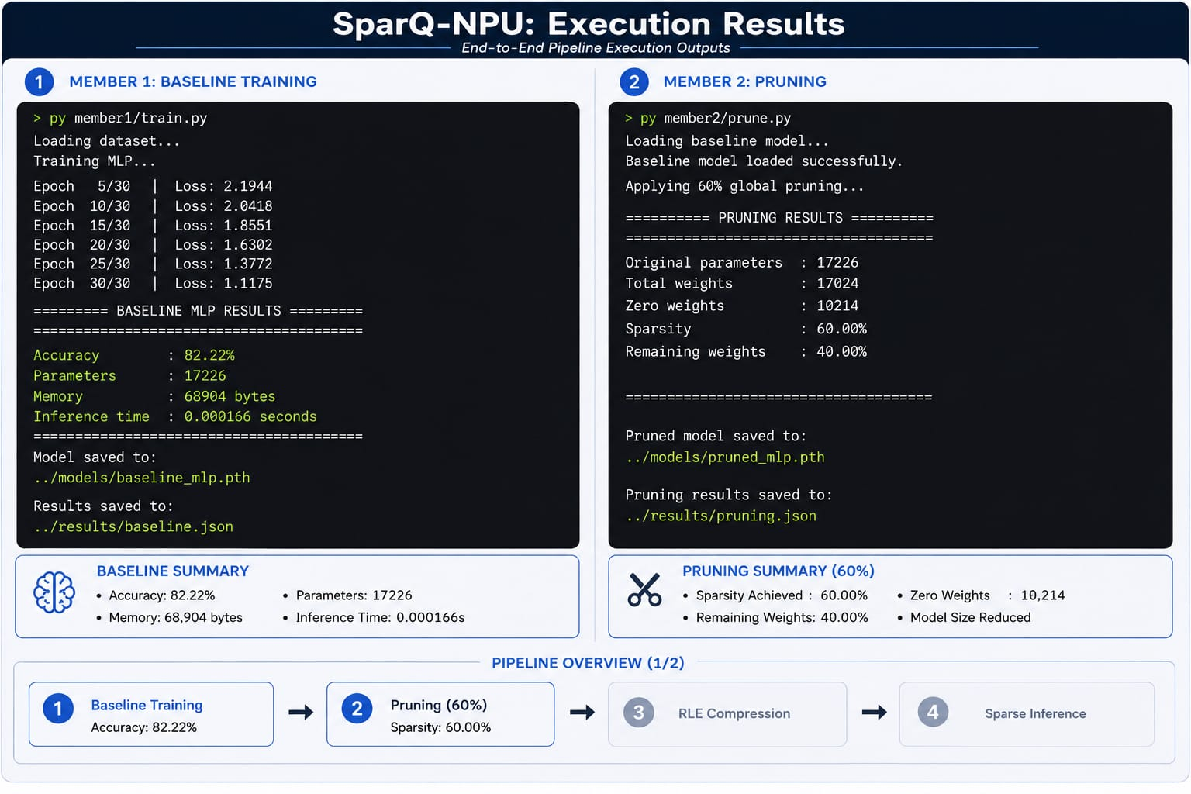

Slide 8
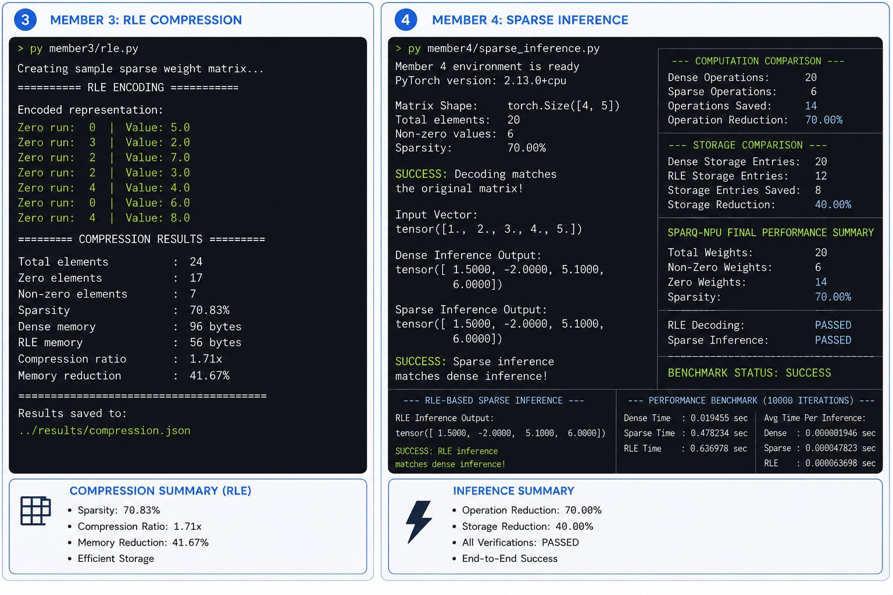

Slide 9
RESEARCH AND REFERENCEs :
RESEARCH AND REFERENCES
Scikit-learn – MLP (Multi-Layer Perceptron) Used for baseline MLP training and evaluation. 🔗MLP Documentation
PyTorch – Model Pruning Used for removing unnecessary weights and creating sparsity. 🔗PyTorch Pruning Tutorial
Deep Compression – Han et al. Research reference for pruning and neural-network compression. 🔗Deep Compression Paper
SciPy – Sparse Data Structures Reference for sparse representation and efficient computation. 🔗SciPy Documentation

Slide 10

1.NO SLIDES SHOULD BE REUSED EXCEPT THE OUTPUT AND RESULT SLIDE (SLIDE 6)
NOTE: MAXIMUM OF 10 SLIDES (NOT MORE THAN THAT)
TRY TO EXPLAIN THE CONTENT IN PROBLEM STATEMENT SLIDE 2 AND THE SOLUTION SLIDE 3 IN A NEAT BULLET POINTS AND TRY TO KEEP REST OF PRESENTATIONS WITH MINIMAL TEXT
3.KEEP YOUR EXPLANATION PRECISE AND EASY TO UNDERSTAND
4.IDEA SHOULD BE UNIQUE AND NOVEL.
5.YOU CAN ONLY USE PROVIDED TEMPLATE FOR MAKING THE PPT WITHOUT CHANGING THE IDEA DETAILS POINTERS (MENTIONED IN PREVIOUS SLIDES).
6.YOU NEED TO SAVE THE FILE IN PDF AND UPLOAD THE SAME ON GITHUB . WORD DOC OR ANY OTHER FORMAT WILL BE SUPPORTED
.
NOTE - YOU CAN DELETE THIS SLIDE (IMPORTANT POINTERS) WHEN YOU UPLOAD THE DETAILS OF YOUR IDEA ON GITHUB.

